Slide 1
Chapter 7
The Design of Digital Systems

Slide 2
Continuing Examples (CE)
CE7. A Mealy system with one input x and one output z such that z = 1 at a clock time iff x is currently 1 and was also 1 at the previous two clock times.
CE8. A Moore system with one input x and one output z, the output of which is
1iff three consecutive 0 inputs occurred more recently than three consecutive 1 inputs.
CE9. A system with no inputs and three outputs, that represent a number from 0 to 7, such that the outputs cycles through the sequence 0 3 2 4 1 5 7 and repeat on consecutive clock inputs.
CE10. A system with two inputs, x₁ and x₂, and three outputs, z₁, z₂, and z₃, that represent a number from 0 to 7, such that the output counts up if x₁ = 0 and down if x₁ = 1, and recycles if x₂ = 0 and saturates if x₂ = 1. Thus, the following output sequences might be seen
x₁ = 0, x₂ = 0: 0 1 2 3 4 5 6 7 0 1 2 3 4 5 6 7 . . .
x₁ = 0, x₂ = 1: 0 1 2 3 4 5 6 7 7 7 7 7 7 7 7 7 . . .
x₁ = 1, x₂ = 0: 7 6 5 4 3 2 1 0 7 6 5 4 3 2 1 0 . . .
x₁ = 1, x₂ = 1: 7 6 5 4 3 2 1 0 0 0 0 0 0 0 0 0 . . .
(Of course, x₁ and x₂ may change at some point so that the output would switch from one sequence to another.)

Slide 3
Step 1: From a word description, determine what needs to be stored in memory, that is, what are the possible states.
Step 2: If necessary, code the inputs and outputs in binary.
Step 3: Derive a state table or state diagram to describe the behavior of the system.
Step 4: Use state reduction techniques (see Chapter 7) to find a state table that produces the same input/output behavior, but has fewer states.
Step 5: Choose a state assignment, that is, code the states in binary.
Step 6: Choose a flip flop type and derive the flip flop input maps or tables.
Step 7: Produce the logic equation and draw a block diagram (as in the case of combinational systems).

Slide 4
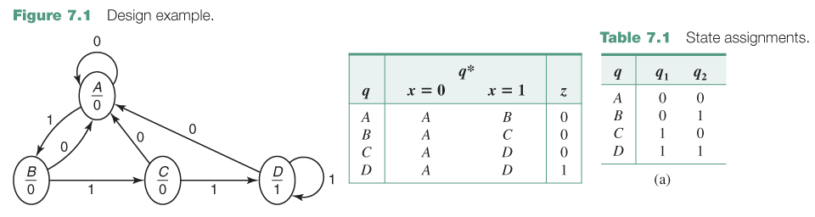
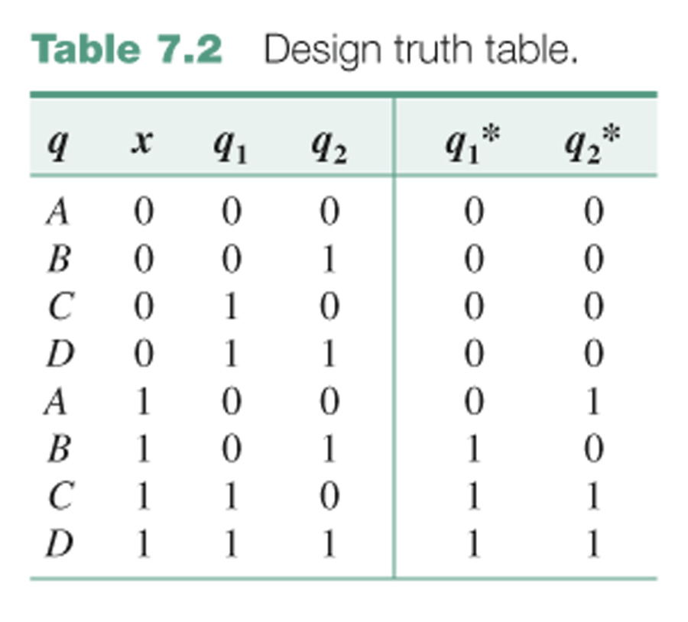
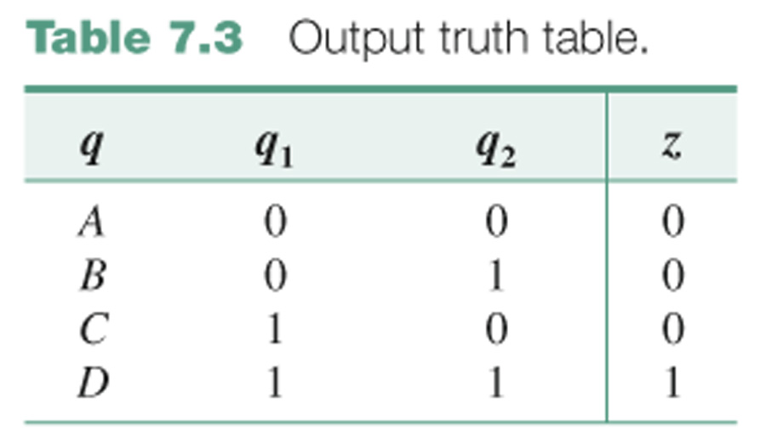

Slide 5
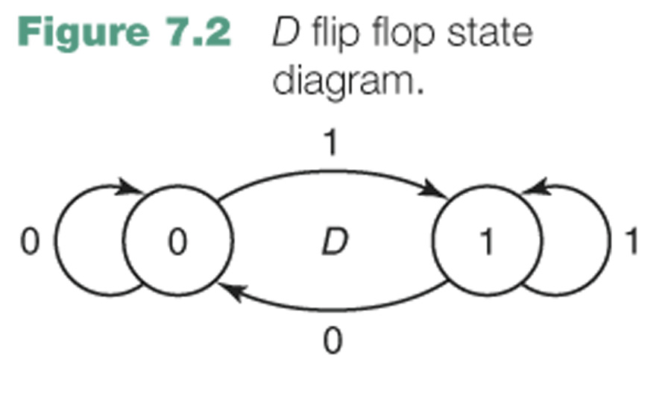
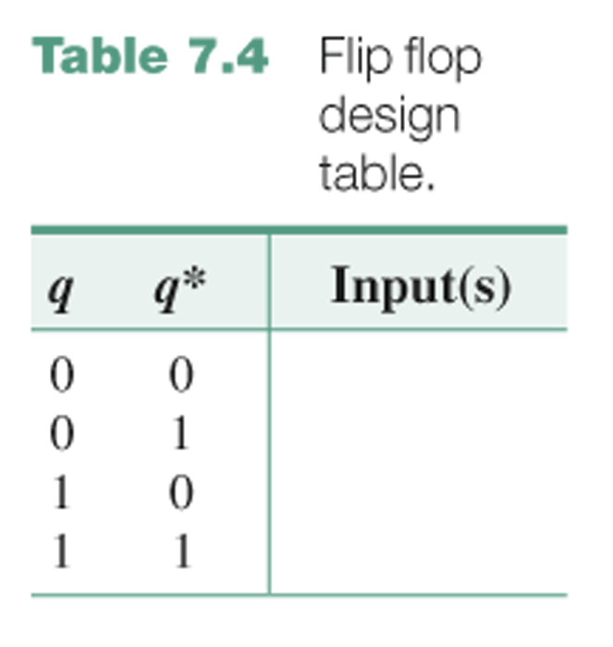
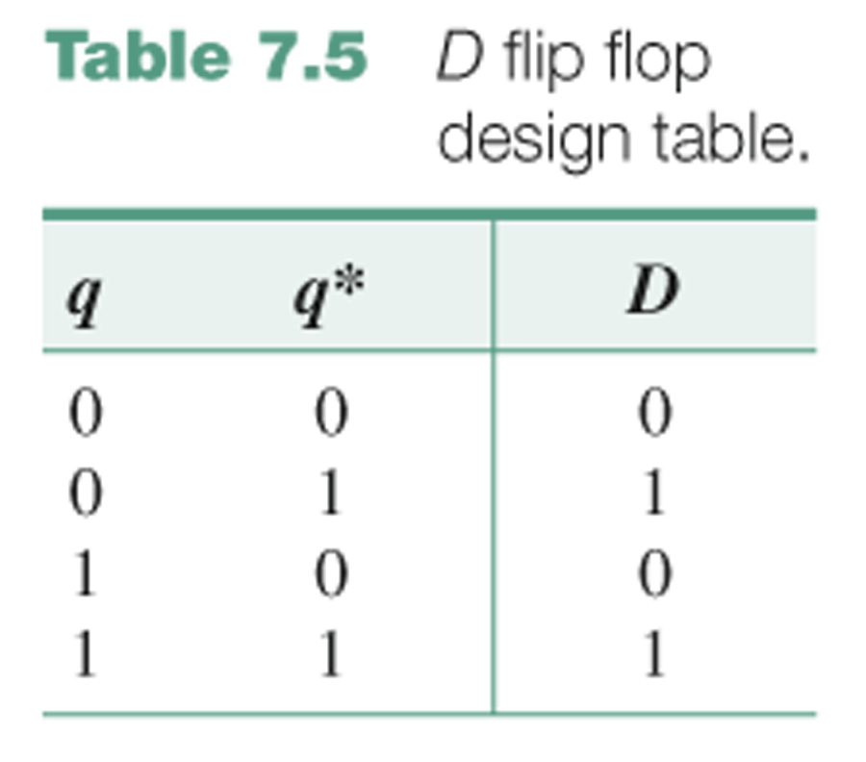
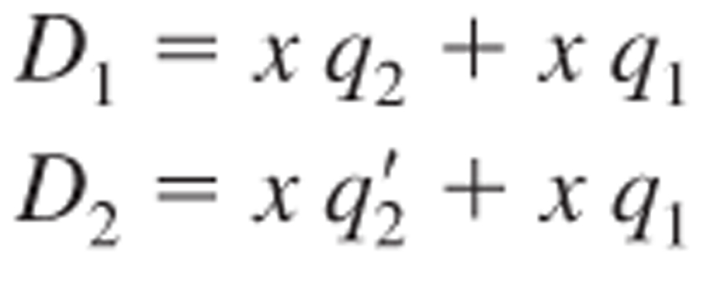

Slide 6
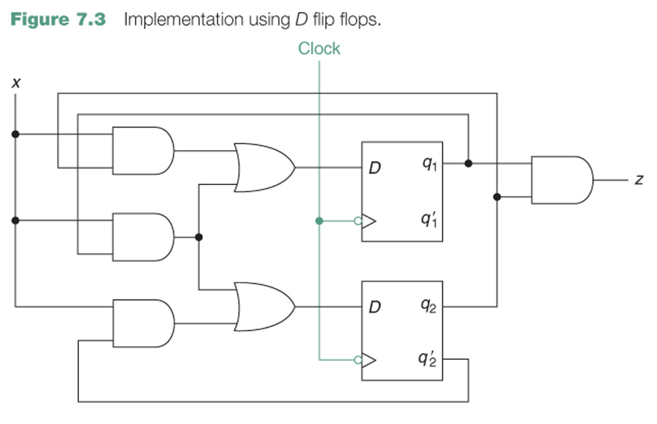

Slide 7
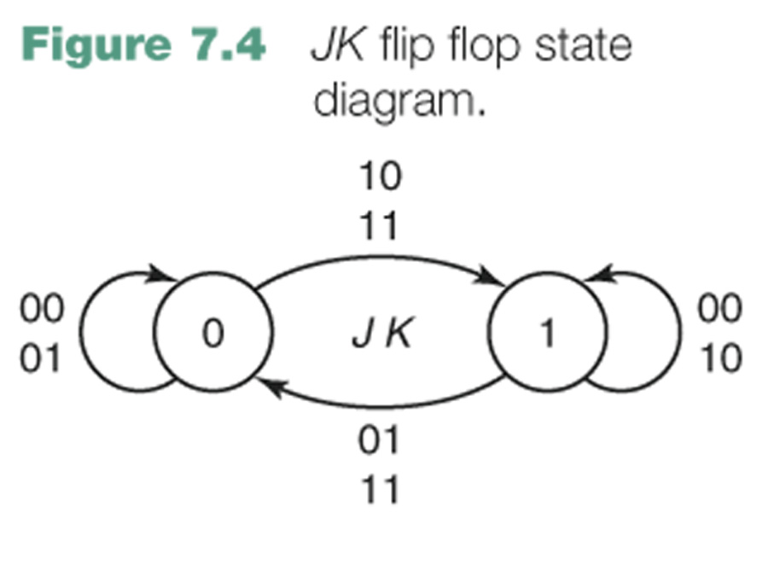
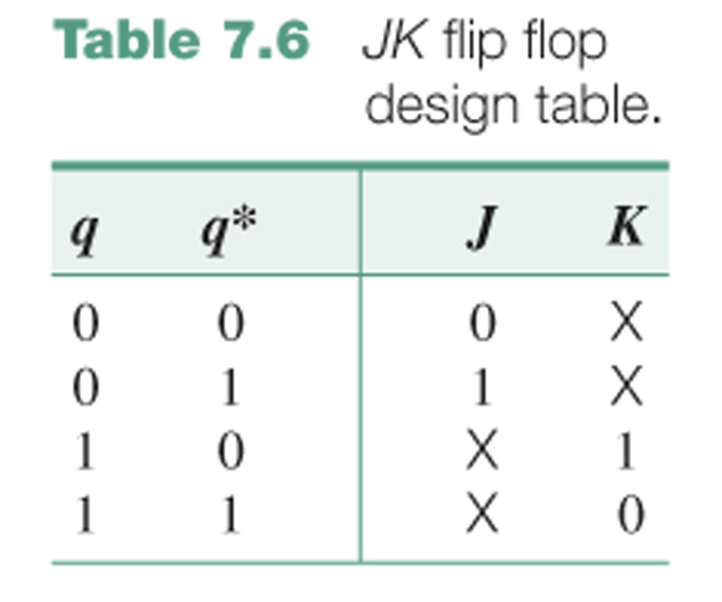
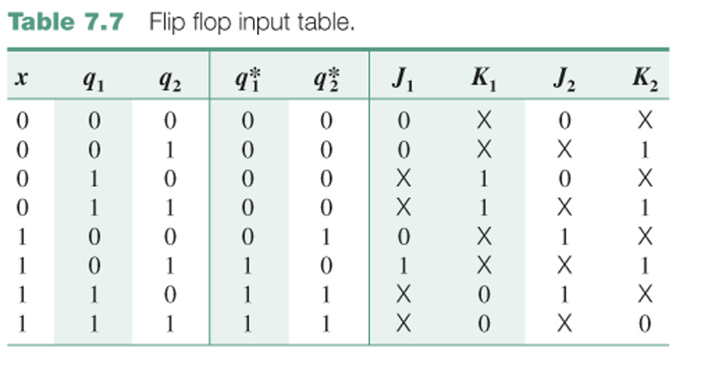

Slide 8
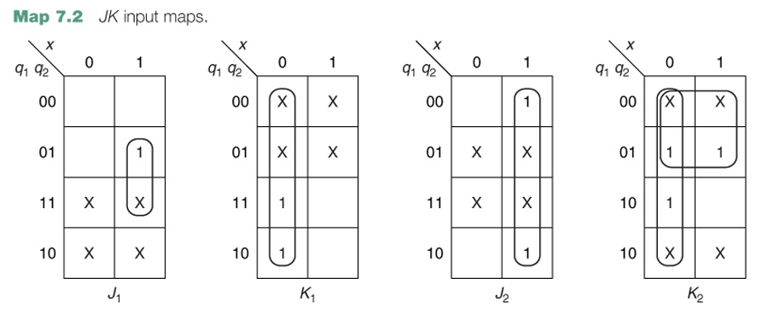
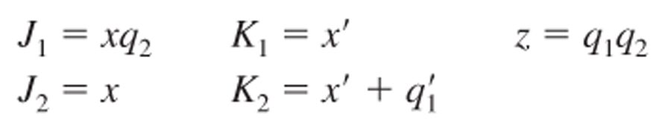

Slide 9
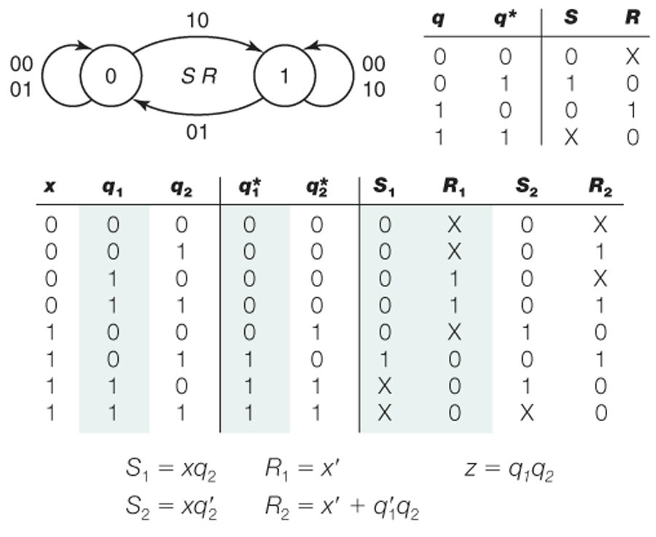

Slide 10
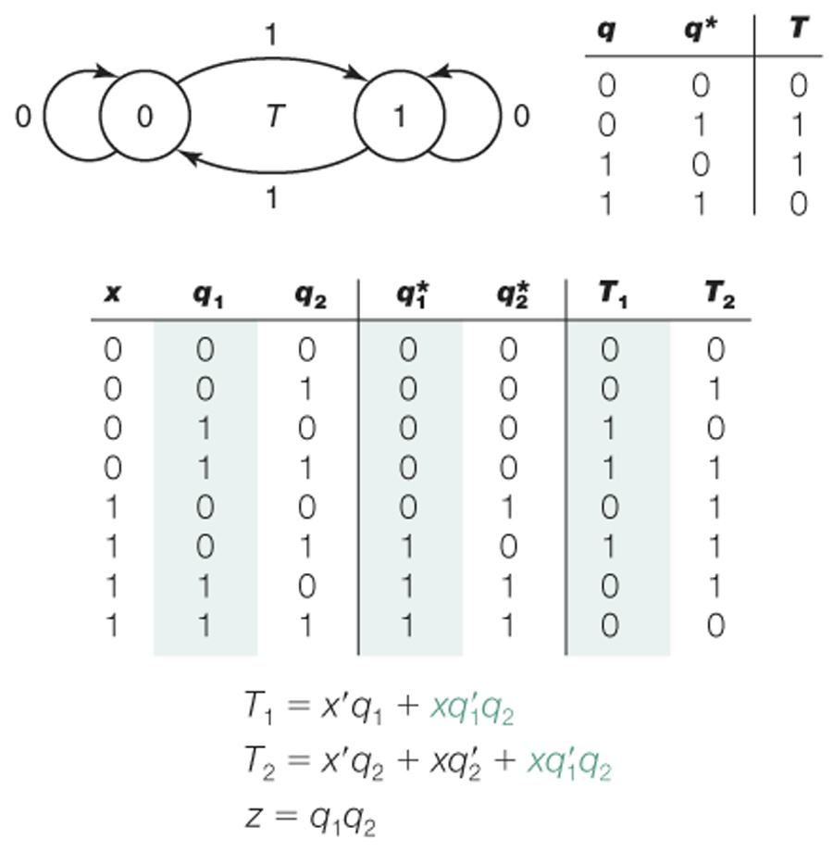

Slide 11
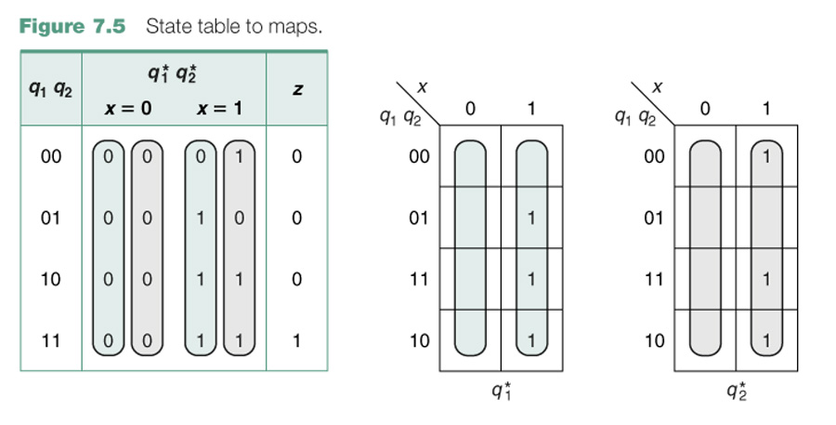

Slide 12
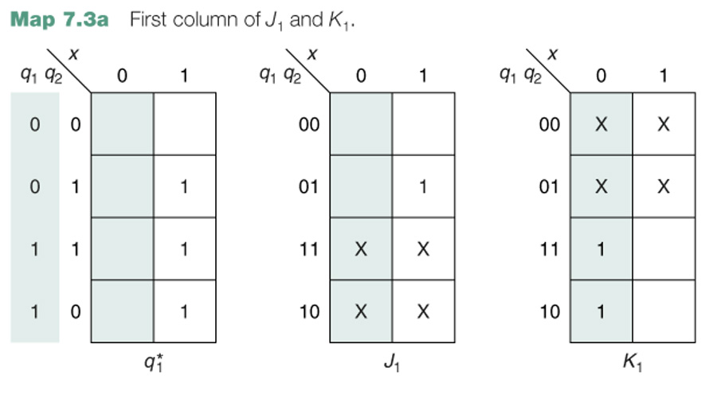
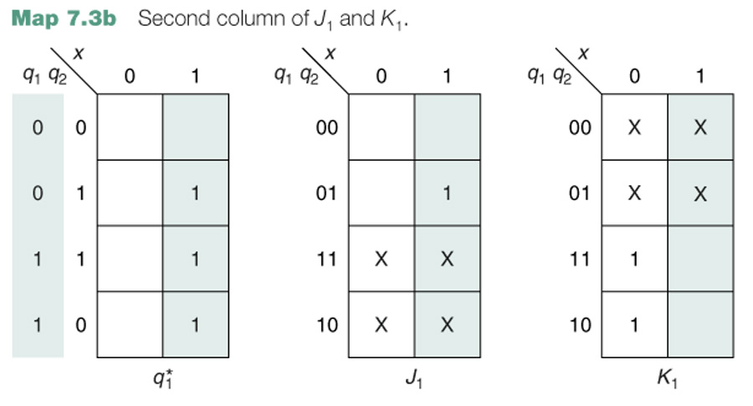

Slide 13
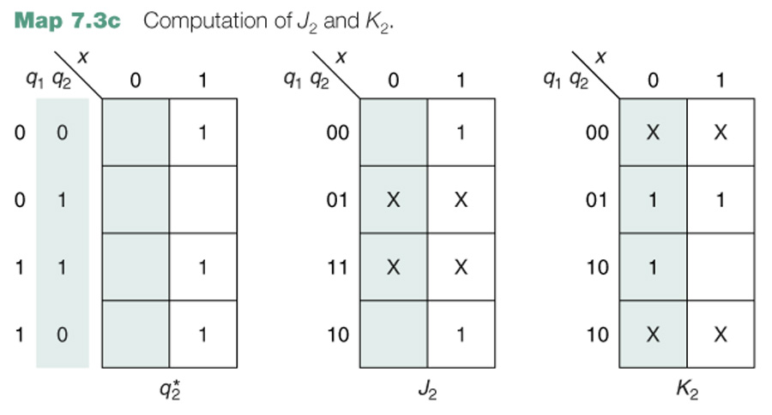

Slide 14
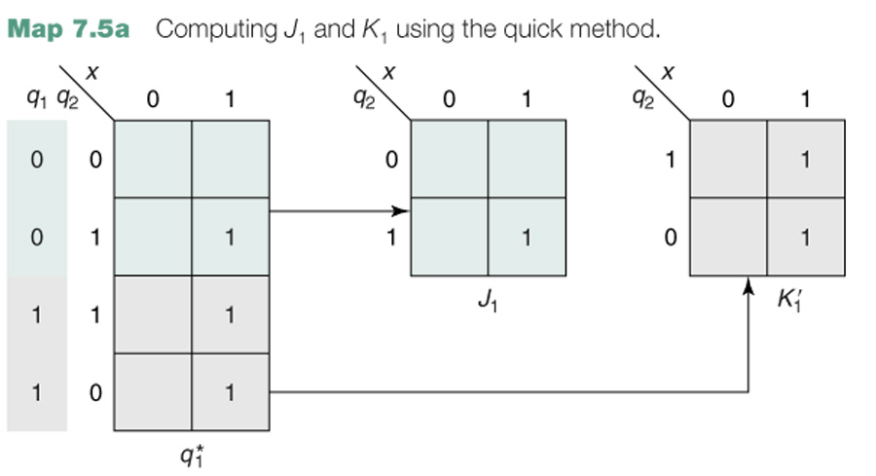

Slide 15
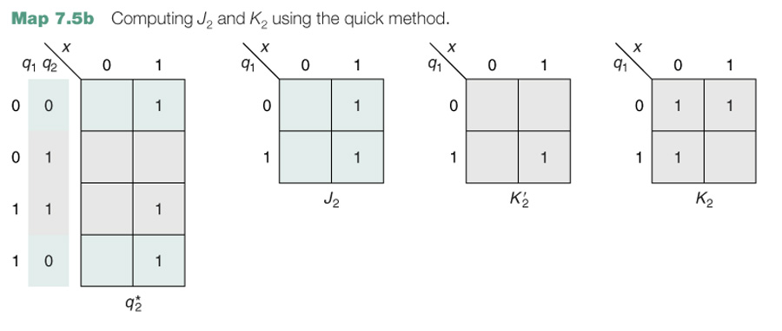

Slide 16
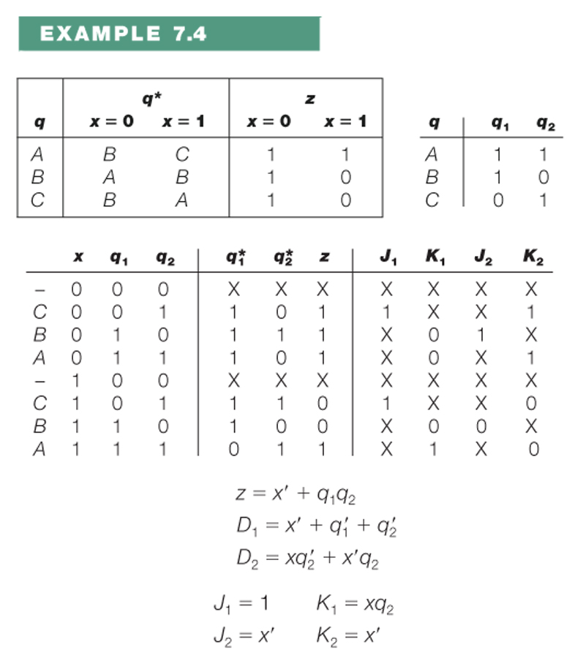

Slide 17
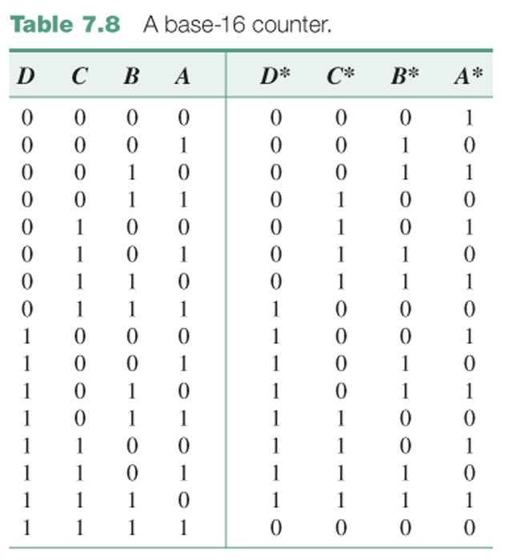

Slide 18
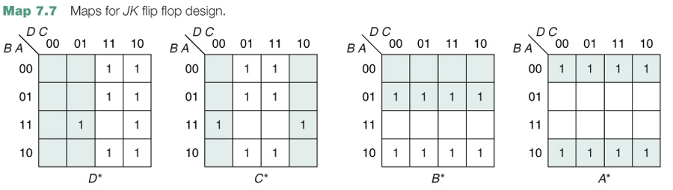
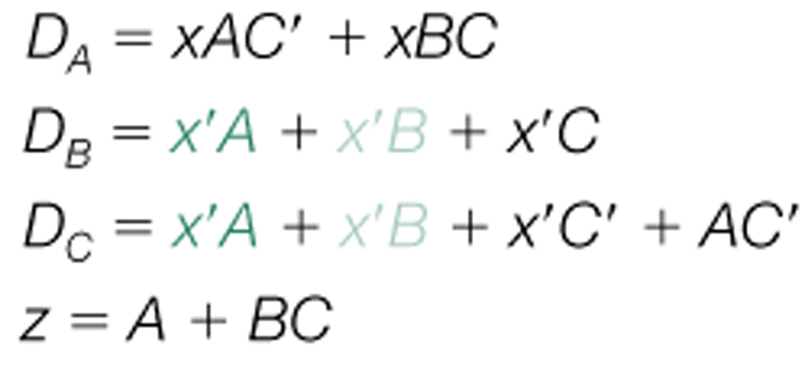
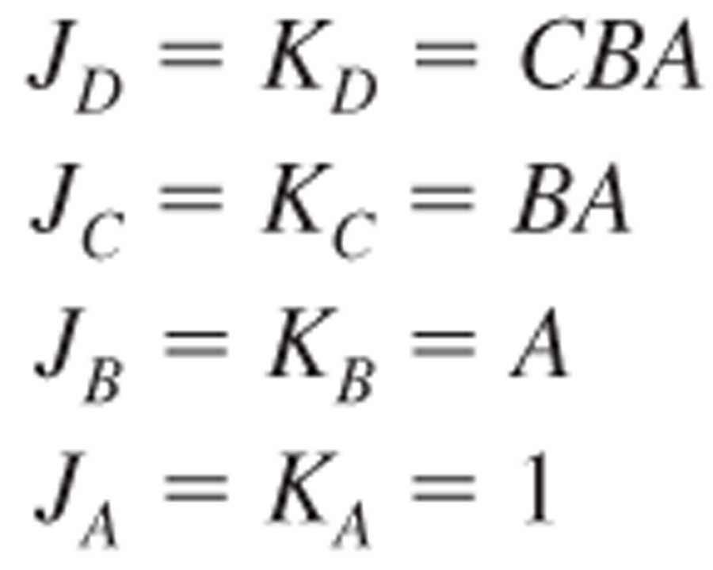

Slide 19
J_{A} = K_{A} = 1
J_{B} = K_{B} = x′A + xA′
J_{C} = K_{C} = x′BA + xB′A′

Slide 20
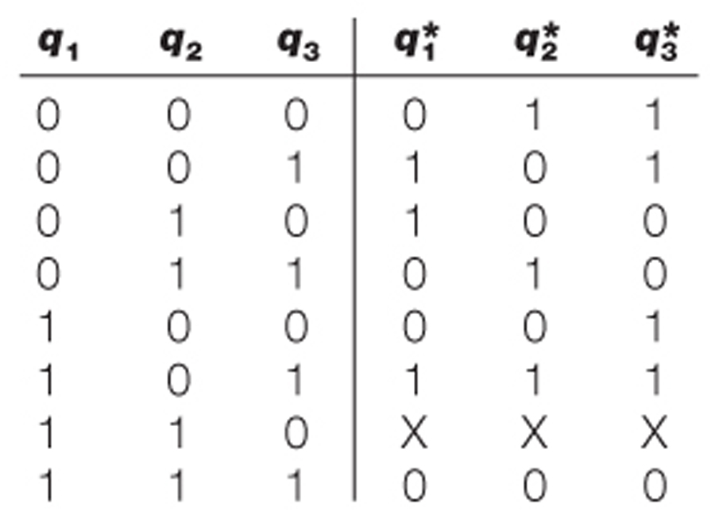
0, 3, 2, 4, 1, 5, 7, and repeat

Slide 21
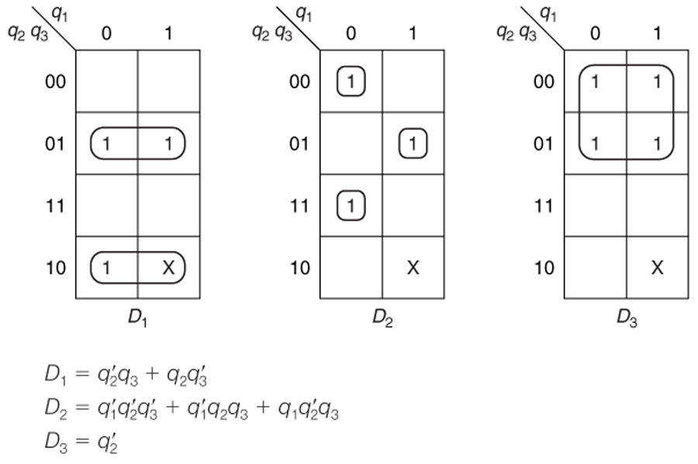

Slide 22
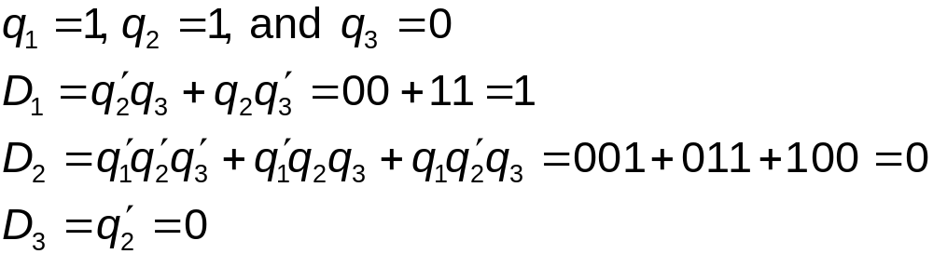
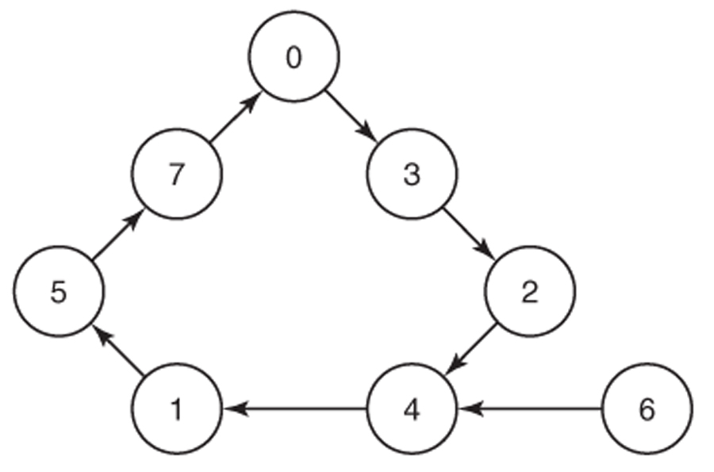

Slide 23
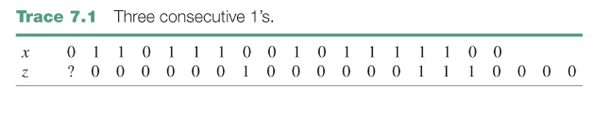
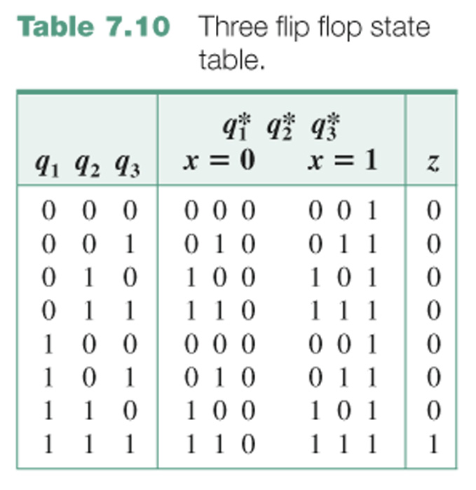
CE6. A system with one input x and one output z such that z = 1 iff x has been 1 for at least three consecutive clock times.

Slide 24
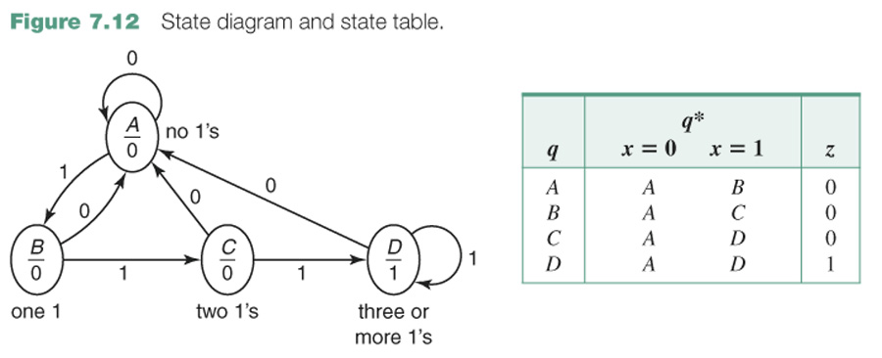
A none, that is, the last input was 0
B one
C two
D three or more

Slide 25
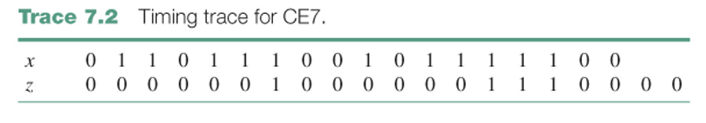
CE7. A system with one input x and one output z such that z = 1 at a clock time iff x is currently 1 and was also 1 at the previous two clock times.
CE7#. A Mealy system with one input x and one output z such that z = 1 iff x has been 1 for three consecutive clock times.

Slide 26
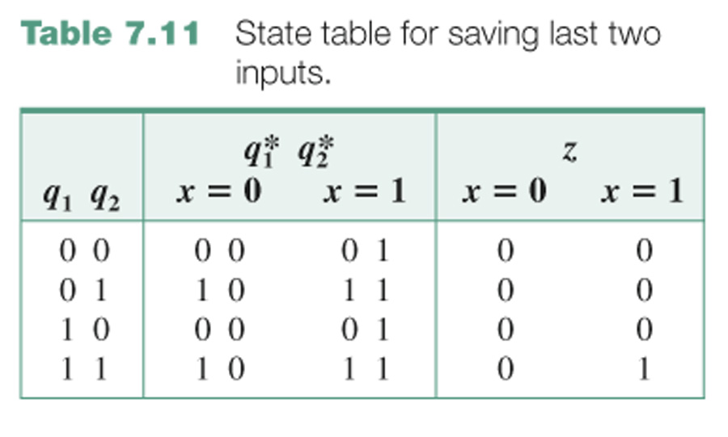

Slide 27
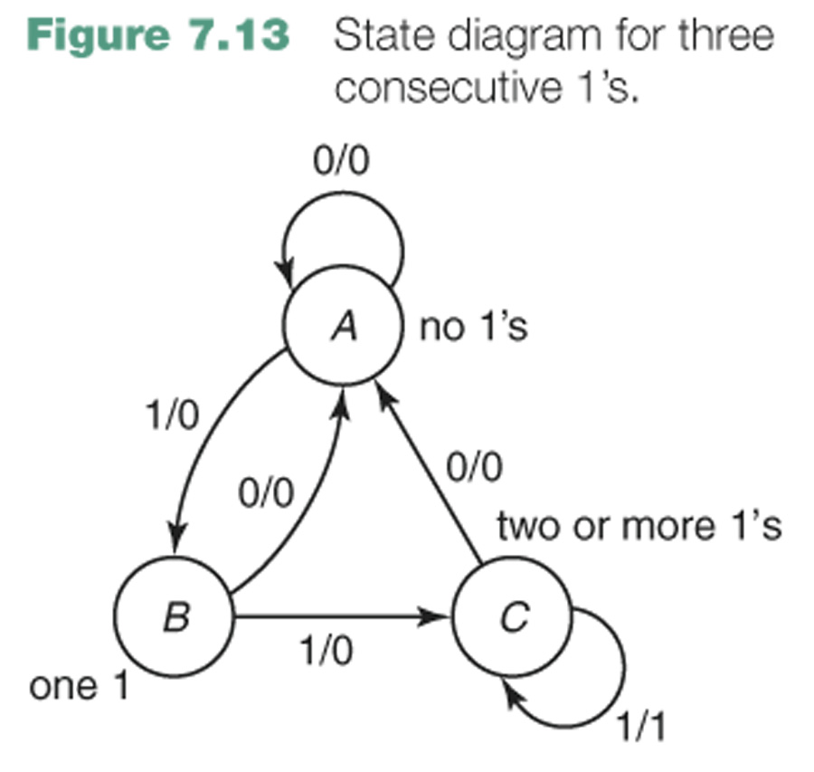
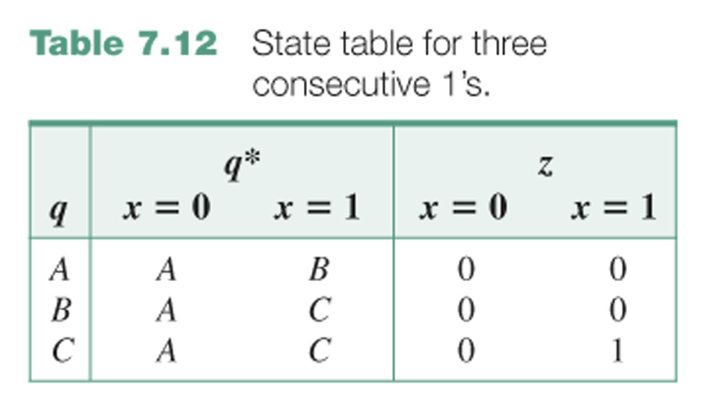
A none, that is, the last input was 0
B one
C two or more

Slide 28
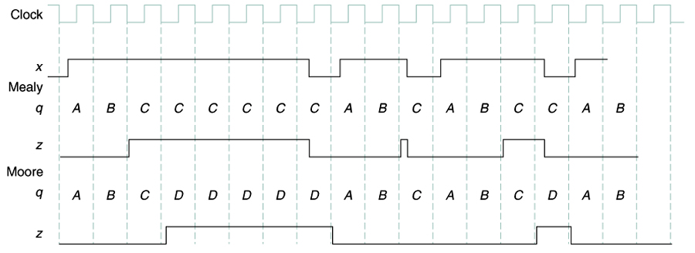

Slide 29
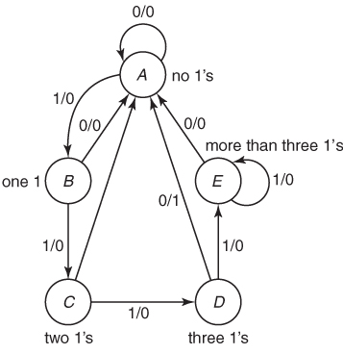
Design a Mealy system with one input x and one output z such that z = 1 iff
x has been 1 for exactly three consecutive clock times.
A sample input/output trace for such a system is
x 0 1 1 1 1 1 1 1 0 1 1 0 1 1 1 0 1
z 0 0 0 0 0 0 0 0 0 0 0 0 0 0 0 1 0 0 0
↑ ↑
A none, that is, the last input was 0
B one 1 in a row
C two 1’s in a row
D three 1’s in a row
E too many (more than 3) 1’s in a row

Slide 30
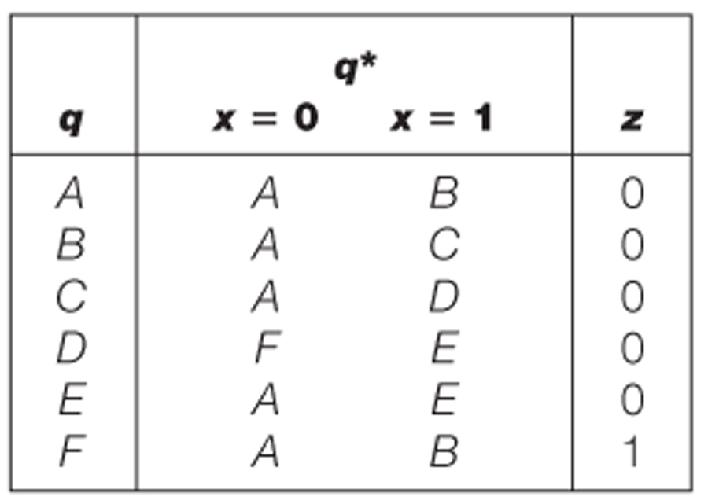
Design a Moore system with one input, x, and one output z such that z = 1 iff
x has been 1 for exactly three consecutive clock times.
x 0 1 1 1 1 1 1 1 0 1 1 0 1 1 1 0 1
z 0 0 0 0 0 0 0 0 0 0 0 0 0 0 0 0 1 0 0 0

Slide 31
